Slide 1


Data-mining
Google Map Data Scraping
Student : LIV Bunthorn
Lecturers: PHAUK Sokkhey, CHAN Sophal

Slide 2
Table of Contents
Introduction
Technology
Tool
Demo
Points for discussion

Slide 3
Introduction
What is web scraping?
Web scraping, web harvesting, or web data extraction is an automatic method to obtain large amounts of data from websites.
1

Slide 4
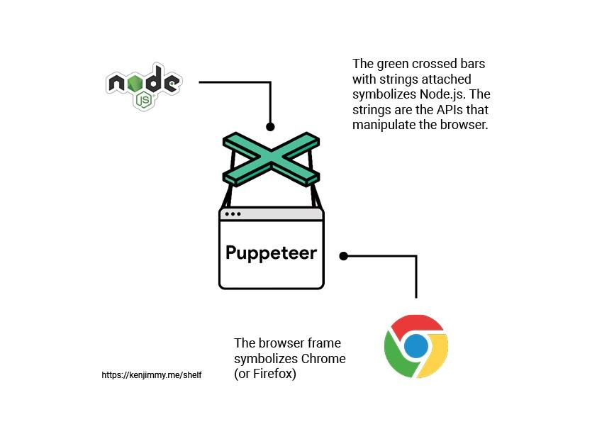
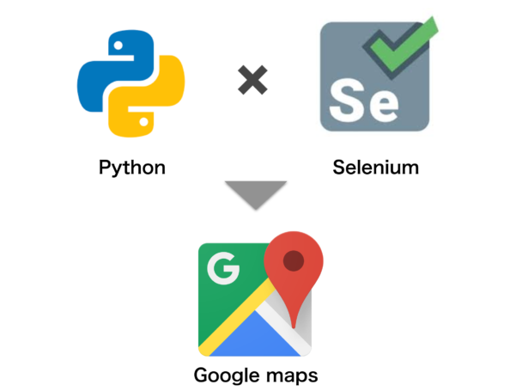
Technology
 | NodeJS Puppeteer
 | Python Selenium, Beautiful Soup
2

Slide 5


Tool
 | Instant Data Scraper Free
 | Gmap leads generator Paid
3

Slide 6

Demonstration
extract data of tourist place from google map
5

